Slide 1
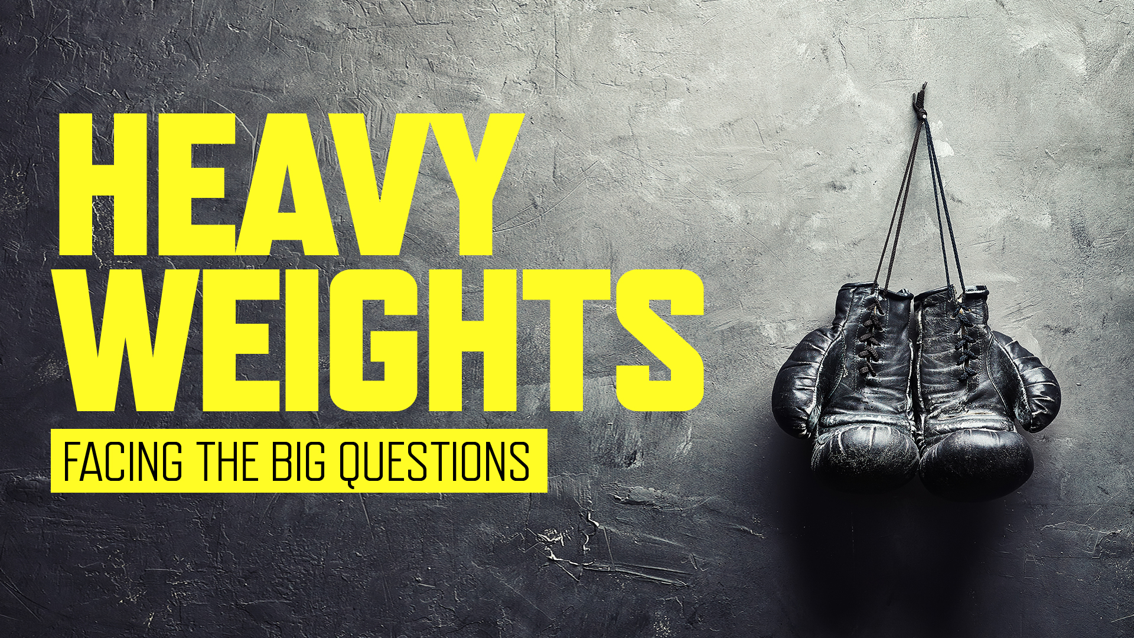

Slide 3
www.mindandsoulfoundation.org
facebook.com/mindandsouluk
@mindandsouluk
Notes:
Play https://vimeo.com/93176291

Slide 4
True Guilt | False Guilt
Repentance brings forgiveness and peace | Repentance never feels like enough
Identity is gained, we are the forgiven children of God | Identity is lost, we do not feel worthy to be called His children
Lack of repentance is also called denial – we lack moral insight | Lack of repentance is not relevant as there is nothing to repent of
Leads us towards God for forgiveness and salvation | Leads us away from God, believing the barrier to be insurmountable
Focuses on the root issue – our damaged relationship with God | Focuses on the detail – all the various sins we think we have committed
Leads to healthy remorse and then to praise and worship | Leads to unhealthy rumination and worry
Is felt more keenly with spiritual maturity, as we realise how human we are | Is felt most keenly when distant from God, and we believe it keeps us there

Slide 5
OWN BACK YARD

Slide 7
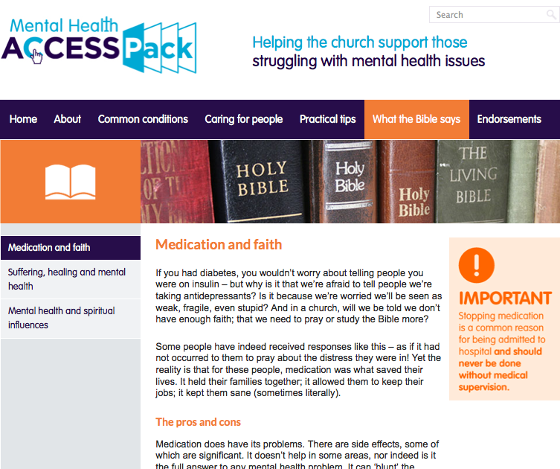
www.mentalhealthaccesspack.org

Slide 8
INTERVIEW

Slide 9
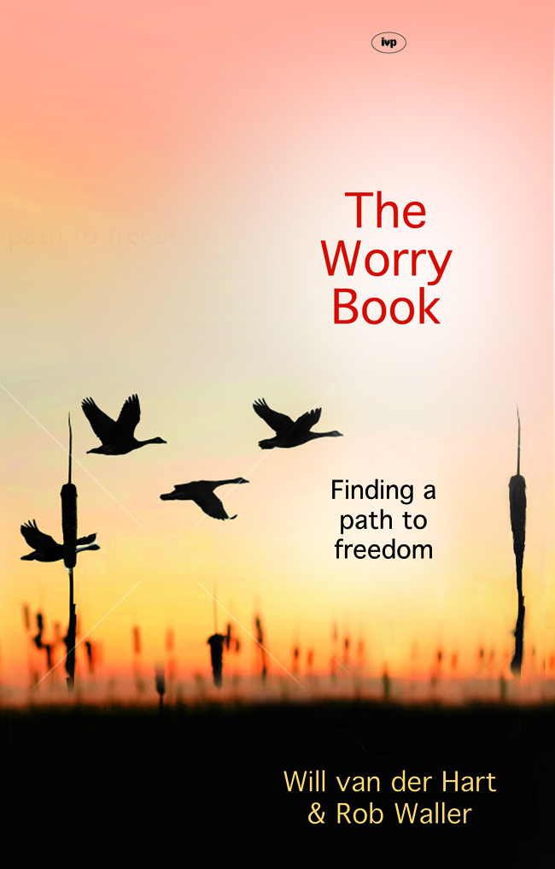
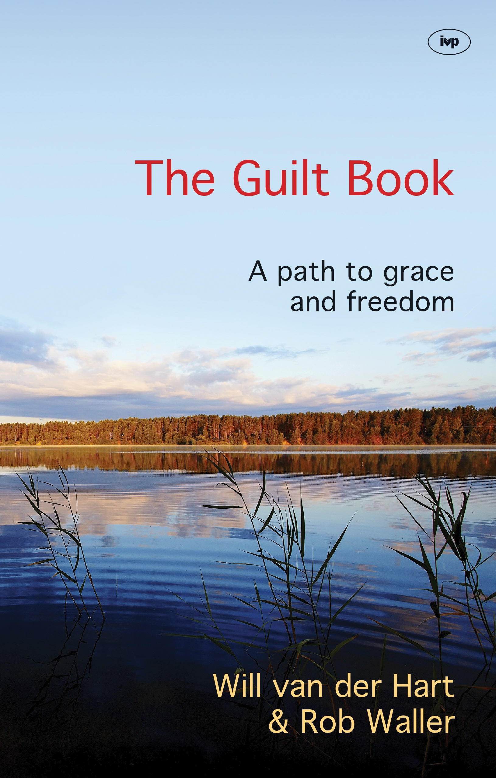
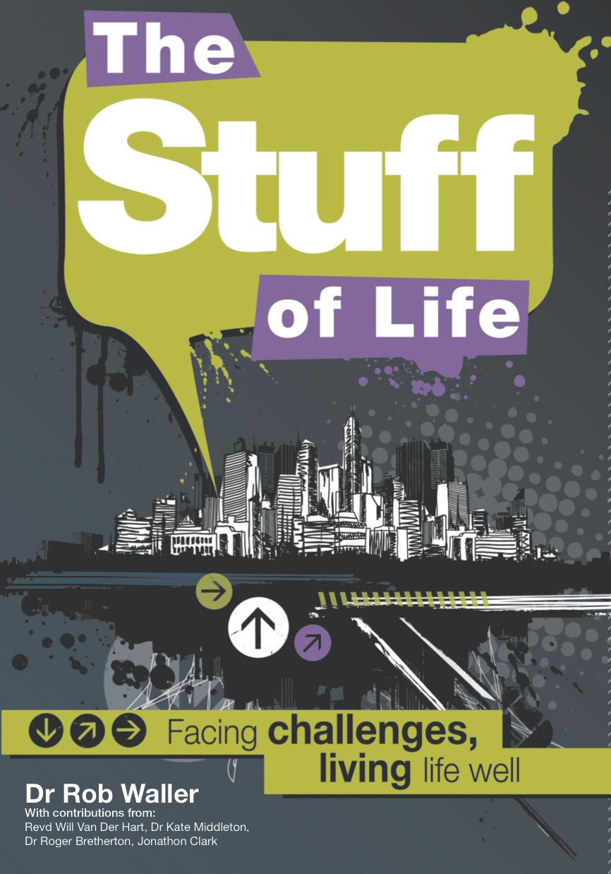
£8
£8
£5

